Slide 1

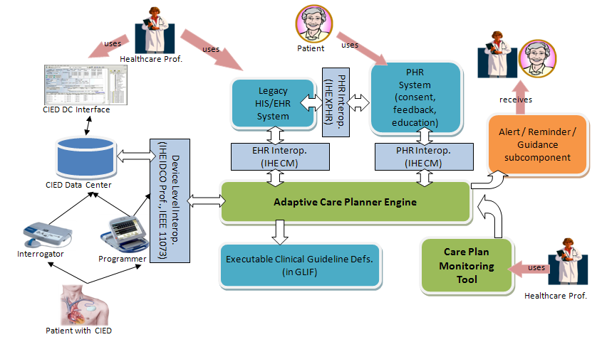

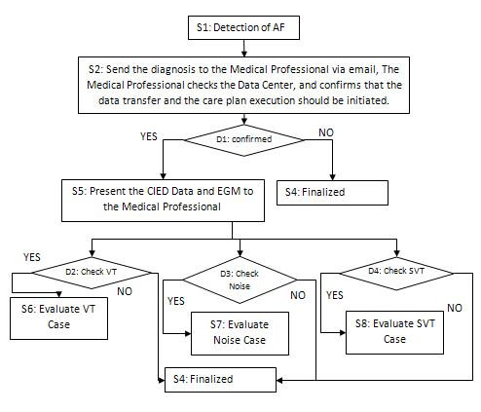















iCARDEA: an intelligent platform for personalized remote monitoring of the cardiac patients with electronic implantable devices
E. Arbelo¹, A. Dogac², C. Luepkes³, M. Ploessnig⁴, C. Chronaki⁵, L. Hinterbuchner⁶, A. Guillen⁷, J. Brugada¹
¹Hospital Clinic, Thorax Institute, Barcelona, Spain ²Software Research, Development, Consultation Ltd., Ankara, Turkey ³OFFIS, Oldenburg, Germany ⁴Salzburg Research Forschungsgesellschaft, Salzburg, Austria ⁵Institute of Computer Science, Heraklion, Greece ⁶Paracelsus Private Medical University, Salzburg, Austria ⁷MEDTRONIC Ibérica, Madrid, Spain
THERE IS NO CONFLICT OF INTEREST
Introduction:
More than 800,000 patients (pt) in Europe have a cardiovascular implantable electronic device (CIED), causing 5.8 million follow-up visits for pt/year. This calls for new methods of long-term surveillance with a view to optimizing pt safety and care, alleviating the burden of caregivers, and lowering health care costs.
Methods:
Data from hospitals’ electronic health records (EHR), from pt maintained personal health records (PHR) and the CIED device readouts, are collected and correlated. We describe the approach and system architecture.
Results:
In order to provide the Adaptive Care Planner, the CIED data is converted into a vendor independent standard format, and EHR and PHR data are converted to HL7 Clinical Document Architecture (CDA) format, in order to be connected to the iCARDEA system. The data presented is enriched by automatically generated patient-specific warnings and suggestions based on statistically valid patterns extracted using state-of-the-art data analysis techniques applied to reference case knowledge bases. An adaptive care planner employing clinical guidelines automates risk assessment generating alarms as appropriate. Pt are empowered with integrated Personal Health Records (PHRs) that enable informed and responsible participation in their health care and education.
Objective:
The iCARDEA Project aims at developing an intelligent platform to semi-automate the follow-up of CIED pt using adaptable computer interpretable clinical guideline models.
35%
Goal:
To reduce the number of in-patient follow-up visits & increase quality of life
To improve patient safety and promote collaborative participatory care
Fig. 2: iCARDEA engages widely adopted interoperability standards
Fig1: iCARDEA aims to advance the state of the art in CIED patient follow-up through clinical guidelines, integrating EHRs, and promoting the use of PHRs in a patient empowerment framework.
HL7 v3 RIM
- to CDA
- to CCR
- to GLIF Info Model
Patient Empowerment
System
IEEE 11073 DIM
To HL7 v3 RIM
Consent Management System
Data Center
Programmer and
The Data Center
IEEE 11073
Domain Information
Model (DIM)
Clinical Knowledge base
Electronic
Healthcare Records
Personal Healthcare Records
Collected Data
Data analysis and Correlation
Physicians access diagnosis data via a web-based portals
Interoperability
IHE/IDCO - HL7 ORU
Collected
Data
Data analysis & Correlation
Clinical Decision Support System
GSM network
Telephone lines
Follow-up visits
(normally
twice a year)
Manufacturer Proprietary
Format
Machine processable
Clinical Guide Lines
Adaptive Care Engine
Transmitter / Interrogator
CIED implanted on patient
Existing Clinical Guide Lines: GLIF, ASBRU, EON
CIED
data
EHRs
PHRs
Transmitter / Interrogator
CIED implanted on patient
Follow-up care plan (workflow)
Contiunation of the “normal” follow-up
Change in pharmalogical treatment
Unplanned patient-visits
Reprogramming of the implanted CIED
Careplan Execution Monitoring
Conclusions:
Making remote monitoring of CIEDs an integral part of collaborative pt care, requires interoperable systems, but can save physicians time, while contributing to higher pt comfort, safety, and quality of life. A clinical trial is planned after completing the system components including the security and privacy measures.
FUNDING: European Community’s Seventh Framework Programme (FP7/2007-2013) – Grant Agreement n.o.: ICT-248240, iCARDEA Project.

